Slide 1

TRADE GUIDE
L’EARN TO TRADE.
THROUGH TRADE.
TEAM MEMBER: -
B SRI KANISHKA REDDY (1602-19-737-111)
JOSHUA PETER (1602-19-737-075)
SRICHARAN (1602-19-737-112)

Slide 2
ABSTRACT
The nature of stock market movement has always been ambiguous for investors because of various influential factors. So, without a proper knowledge about the crypto or stocks or shares of a certain company and their past performances, their money is significantly at a high risk. So, the trading guide is an online platform to know and learn about how the exchange works in the current world. How to trade and when to trade (to know the right time to invest) and to be up to date with the opportunities in the market . Here at trading guide we aim to help educate the world on the ever-growing crypto currency market. And to help them become confident and successful trader. From understanding how crypto works to learning how to invest into it. The trading guide helps us in giving basic knowledge and the befits on long term and short-term trading and helps us to know when to invest so that the risk is minimized.
One of the most successful investor of all time Warren Buffett has once said – “IF YOU DON’T FIND A WAY TO MAKE MONEY WHILE YOU SLEEP. YOU WILL WORK UNTIL YOU DIE”.

Slide 3
It helps to know how actual value of a particular share or stock has been changing according to trends in the market .
We will also provide the user a detailed statistical information about the stocks as well as crypto and let understand the present market trends .
This statistics that we mentioned above will be more helpful for the user to invest in stocks and in crypto as well…..

Slide 4
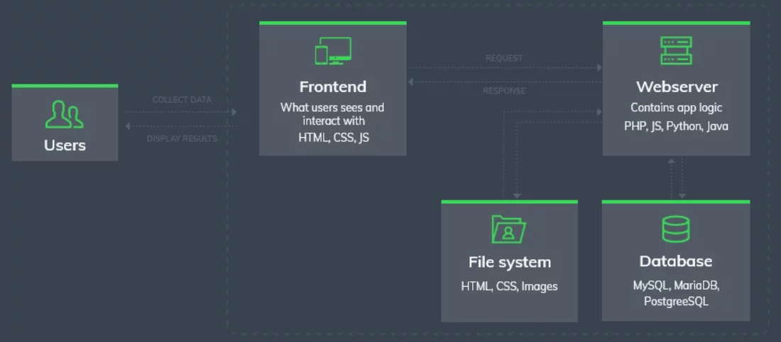
ARCHITECTURE: -

Slide 5
SYSTEM REQUIREMENTS
Software Requirements:
INTERPRETER:
Visual Studio Code
Text Editor
Architecture and Technology:
Use Front-End:
1) HTML
2) CSS
3) JAVA SCRIPT
4) BOOTSTRAP
Back-End:
1) MySQL

Slide 6
REFERENCES
https://www.geeksforgeeks.org/
https://www.tutorialspoint.com/index.htm
https://getbootstrap.com/
https://www.w3schools.com/

Slide 7
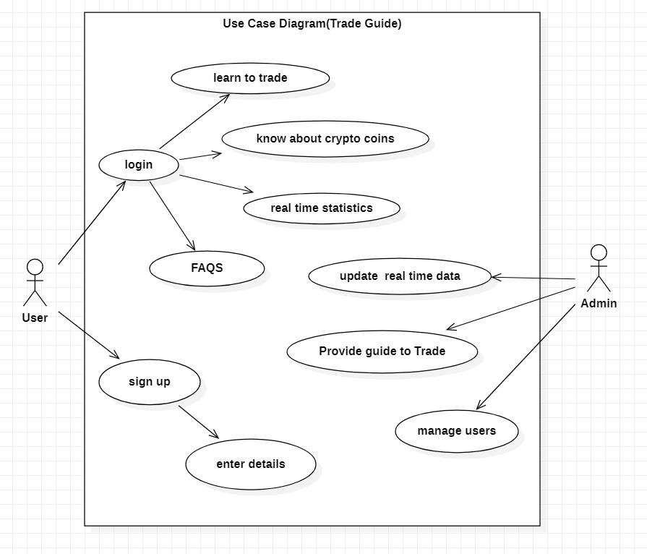
USE CASE :

Slide 8
Design of our web page: -
Login/Register page
Home page
How to Trade(providing guidance to the user)
Know different crypto coins and their importance
Statistics – to analyze the market trends
FAQS

Slide 9
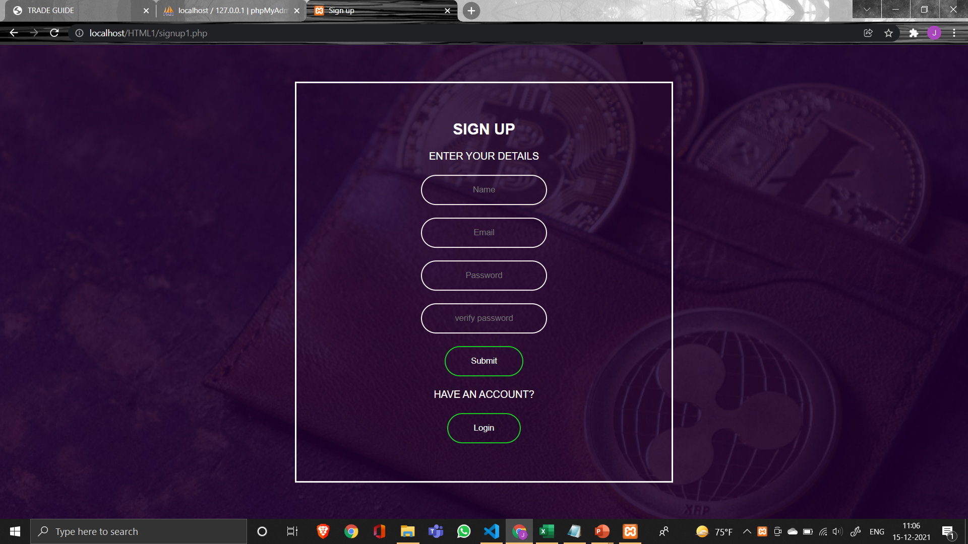
SIGNUP PAGE :

Slide 10
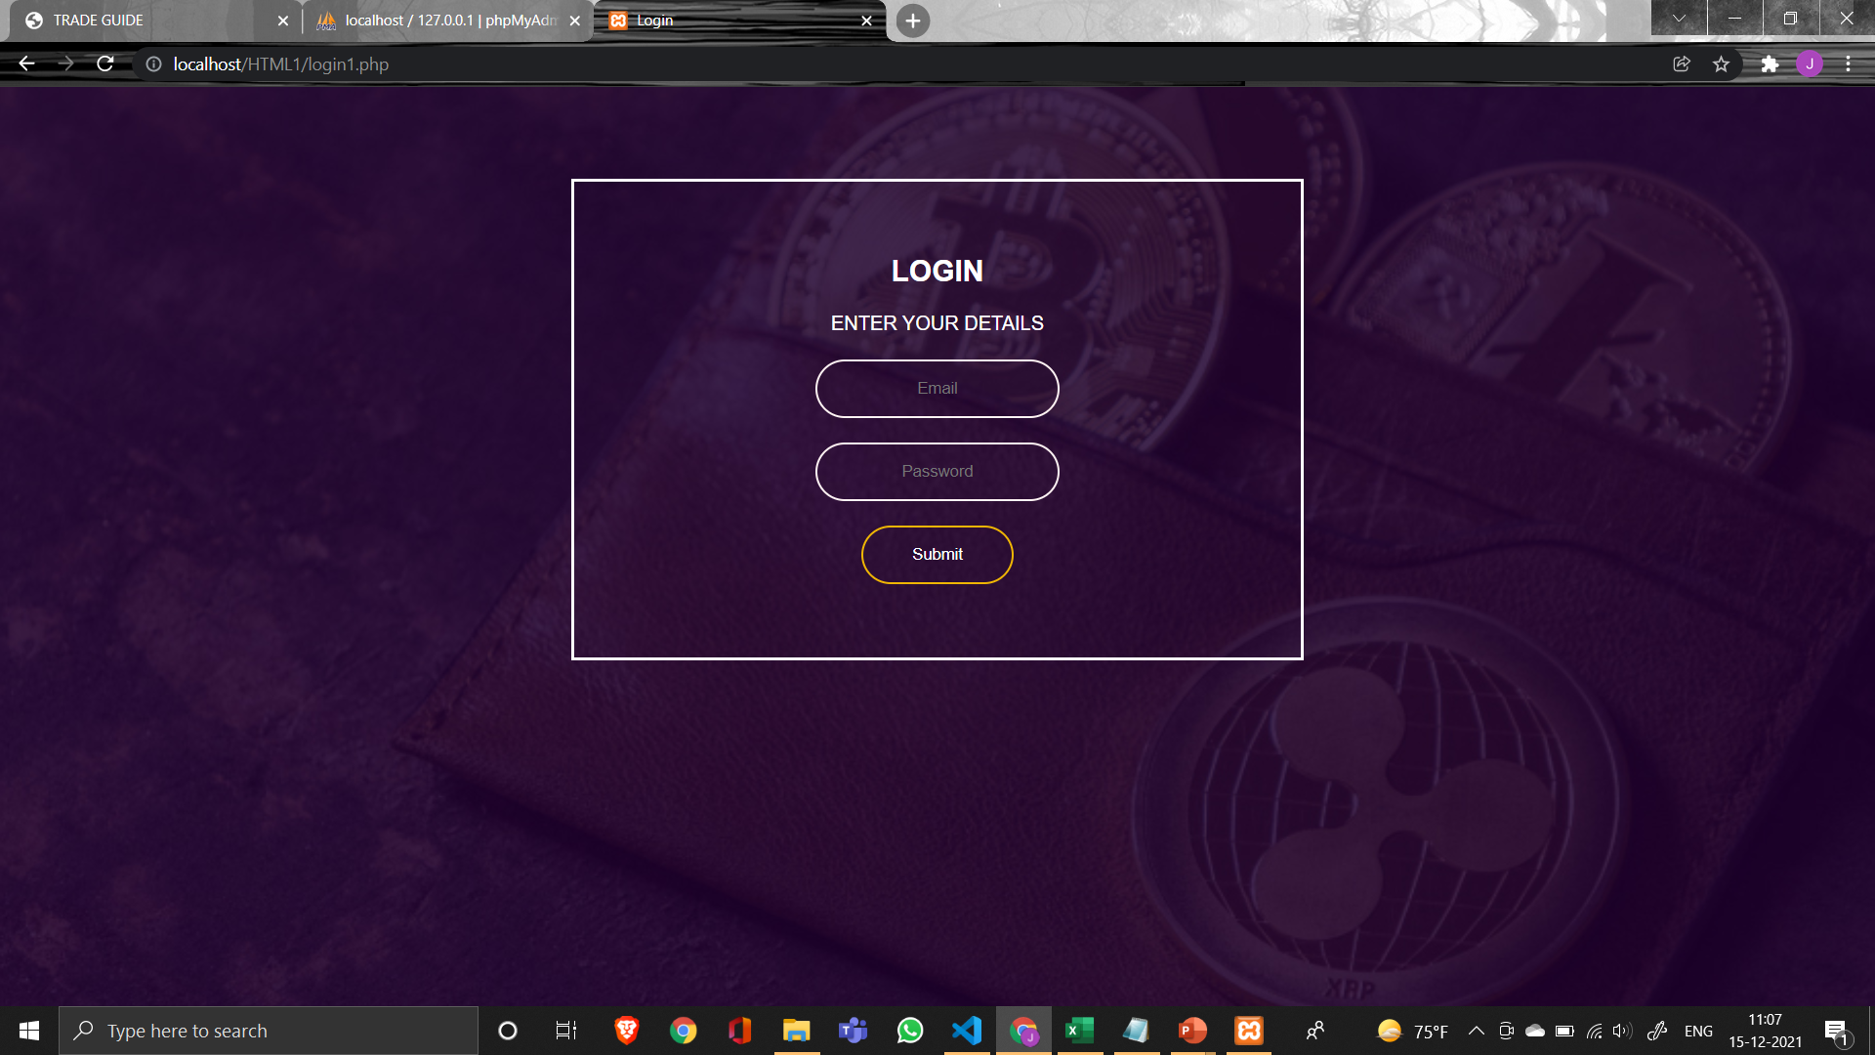
LOGIN PAGE :

Slide 11
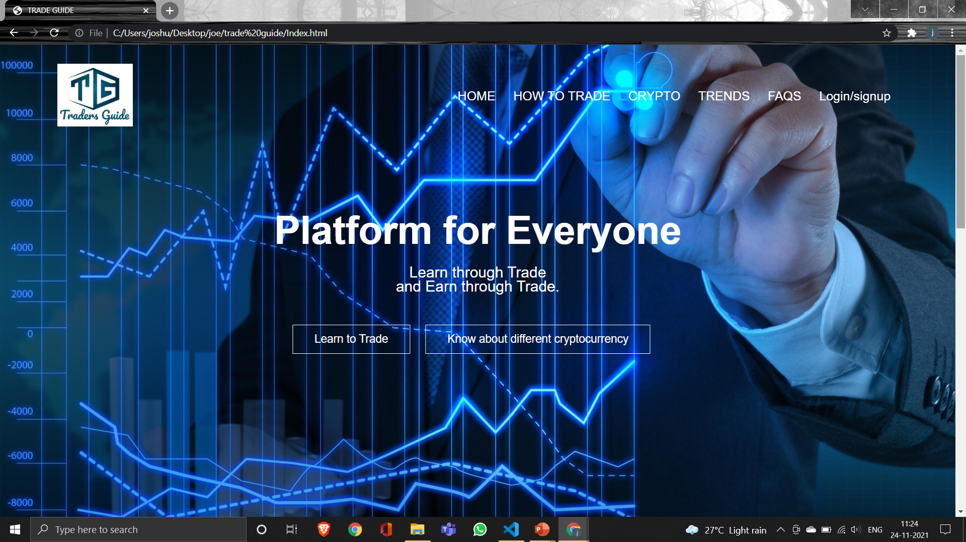
HOME PAGE :

Slide 12
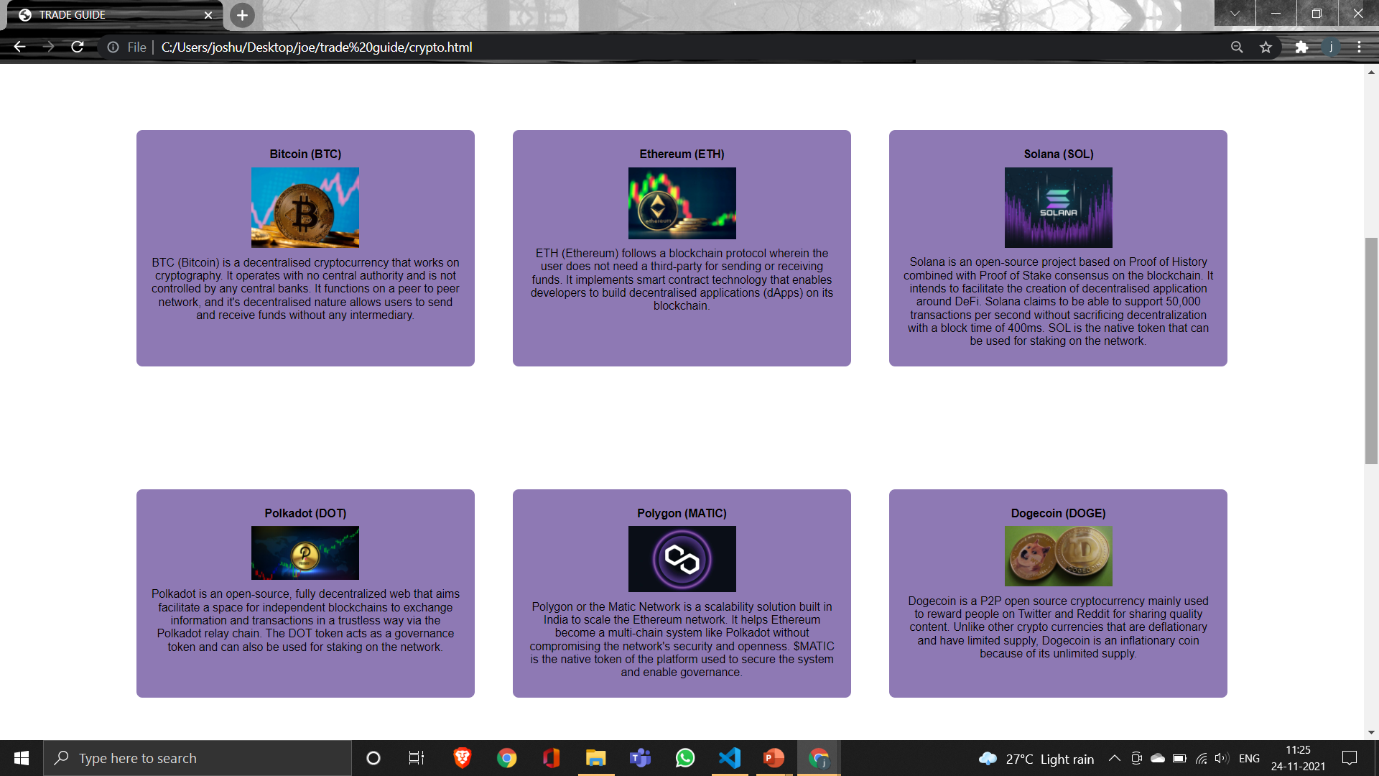
DIFFERENT CRYPTOCURRENCY PAGE :

Slide 13

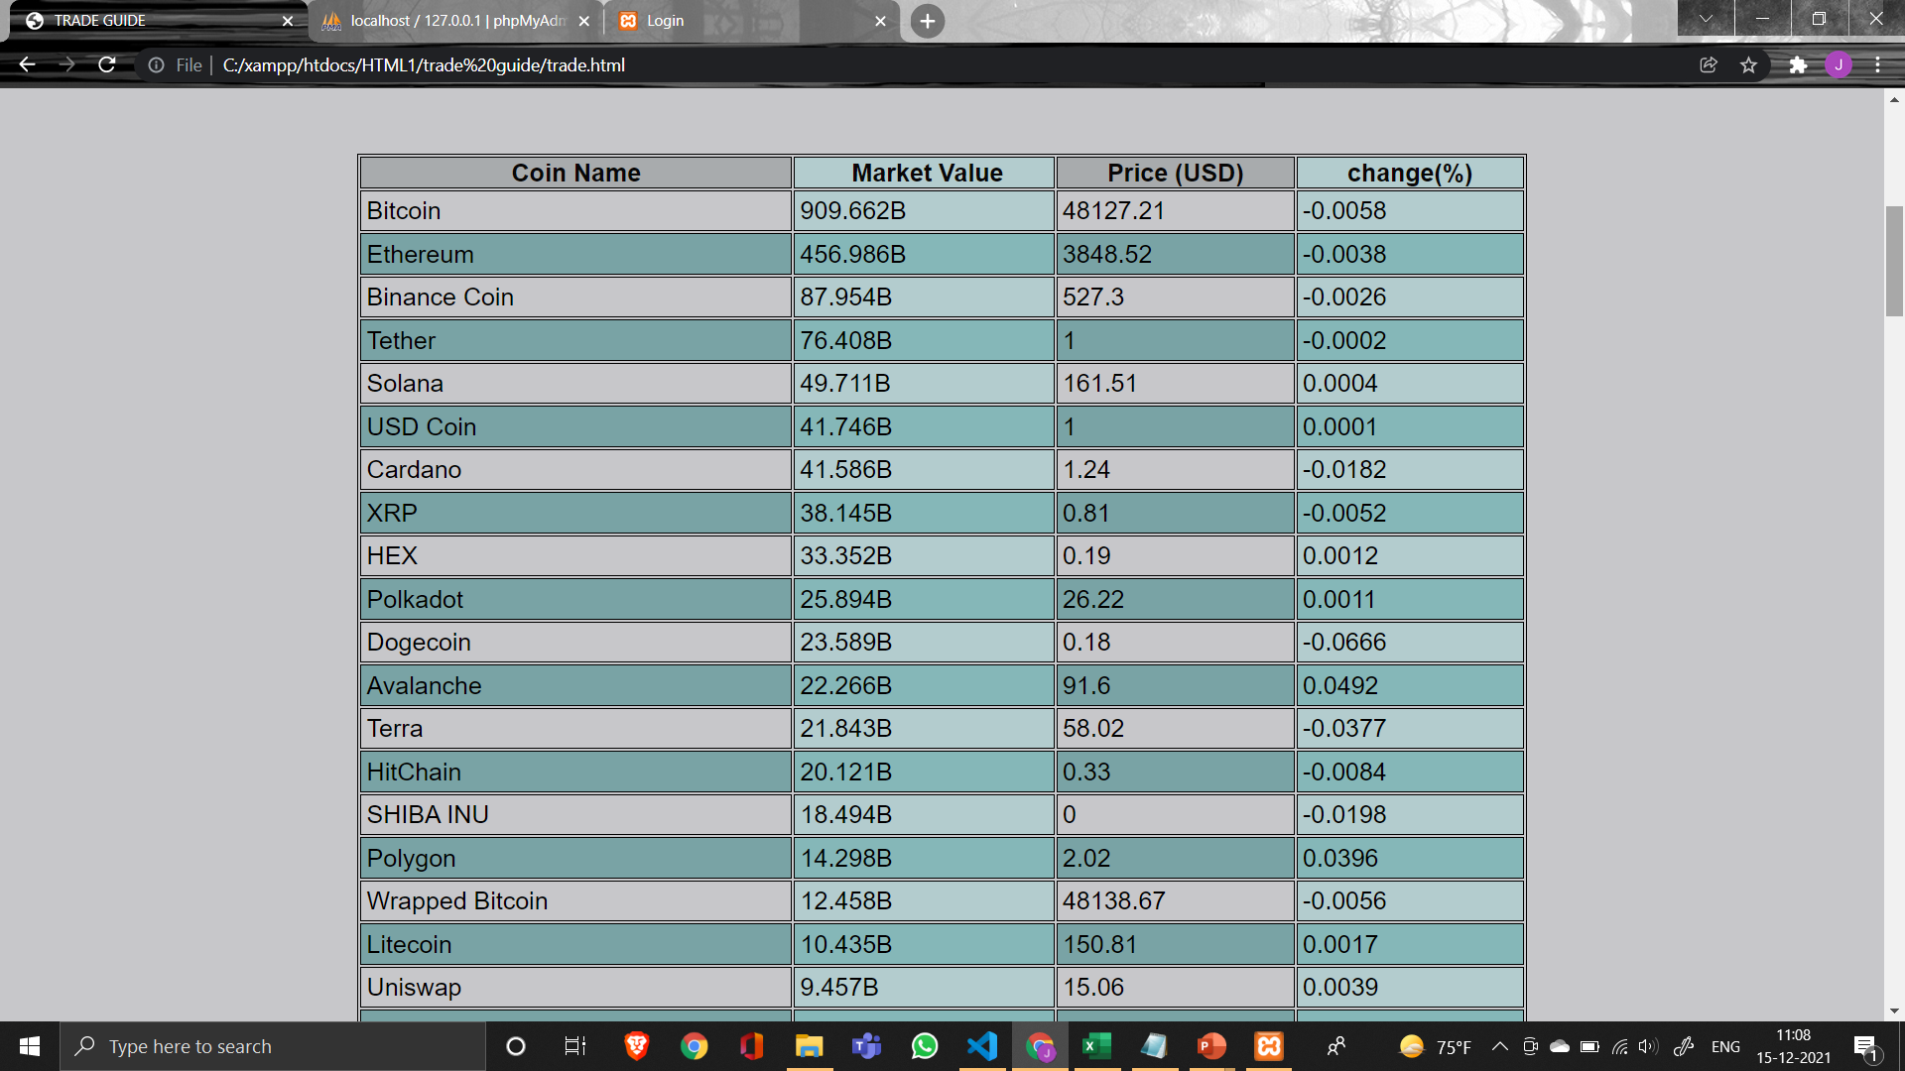
CRYPTOCURRENCY PRICES :

Slide 14
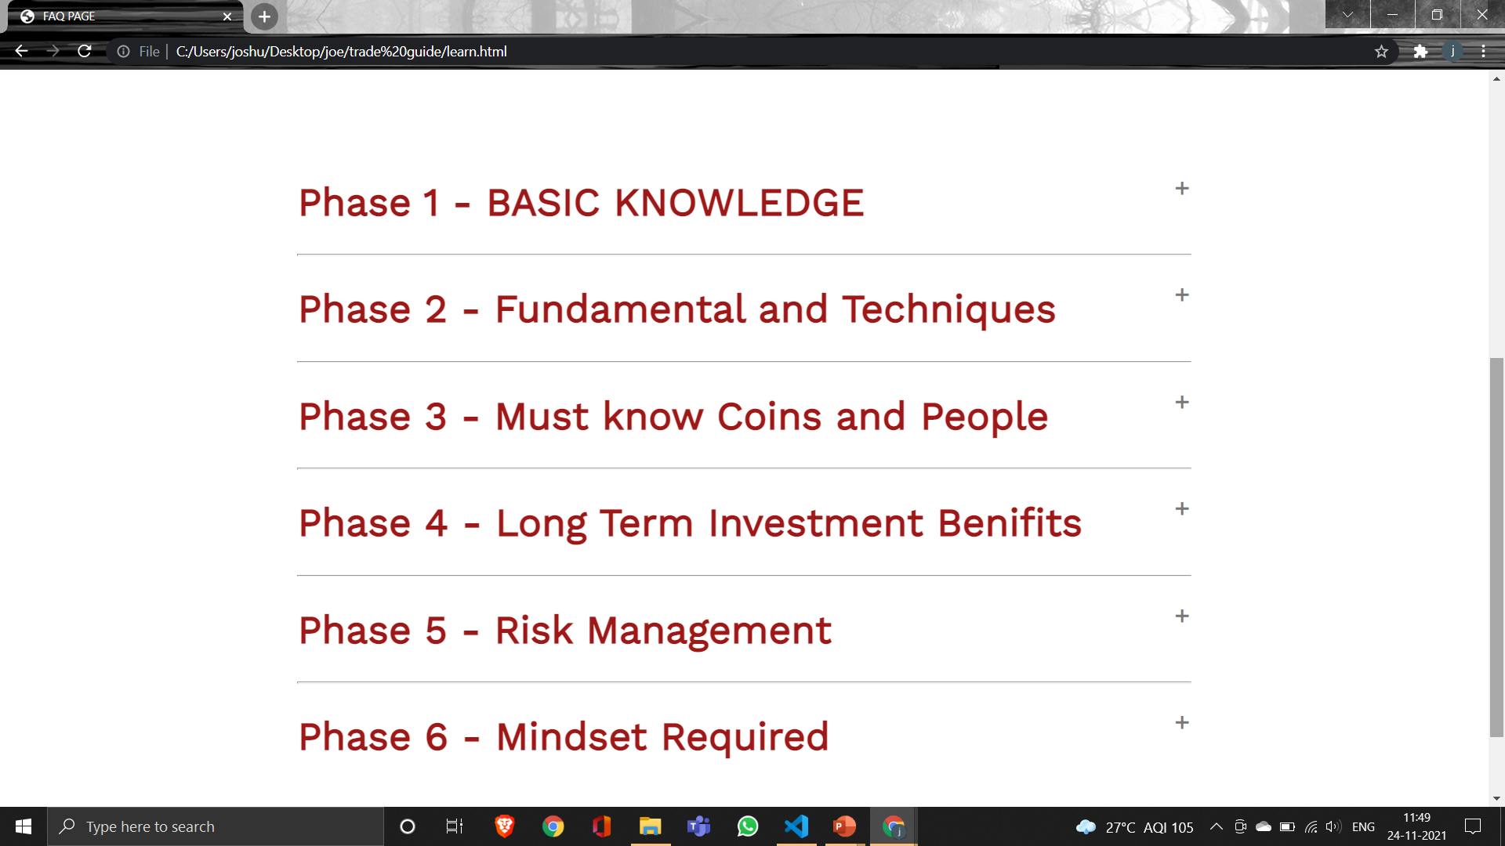
How to Trade PAGE :

Slide 15
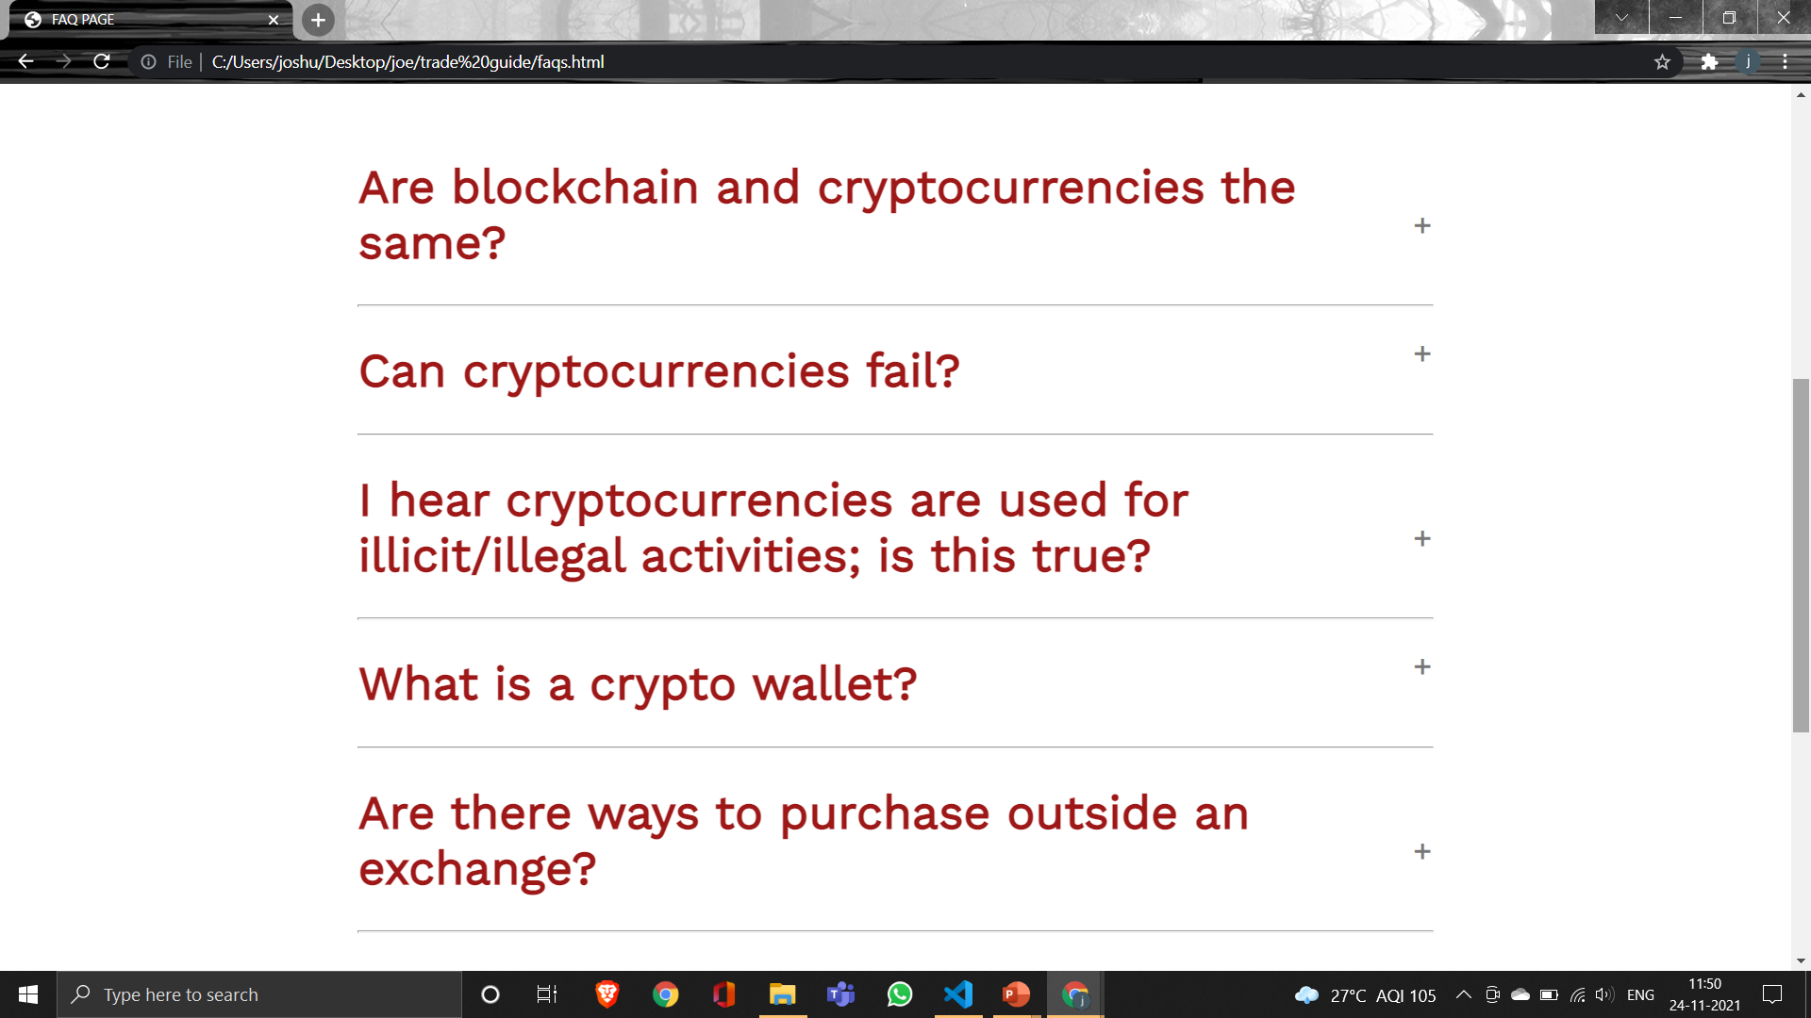
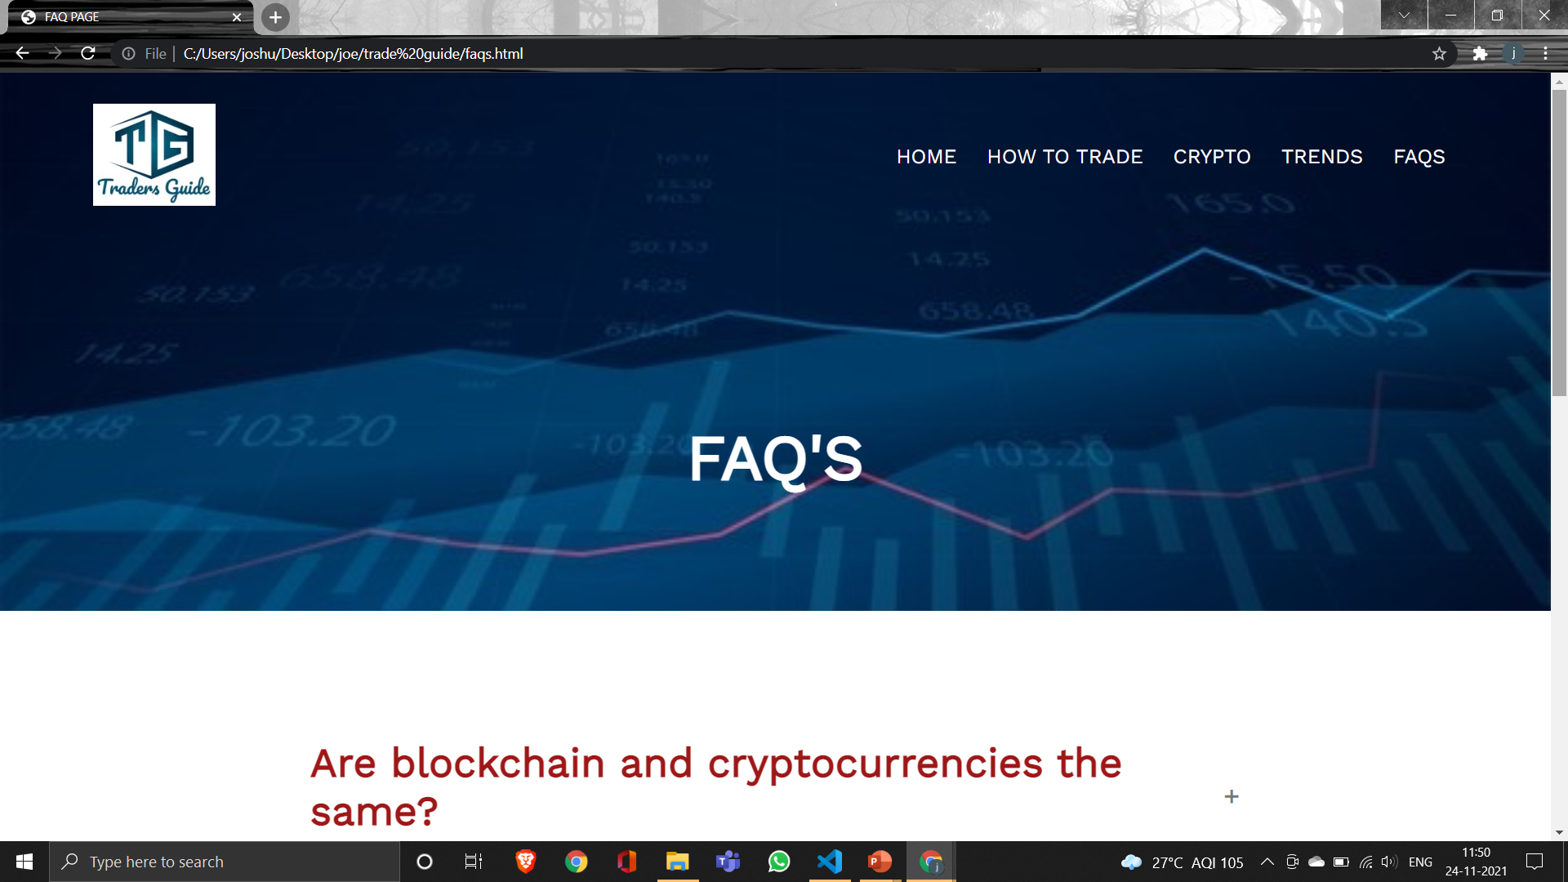
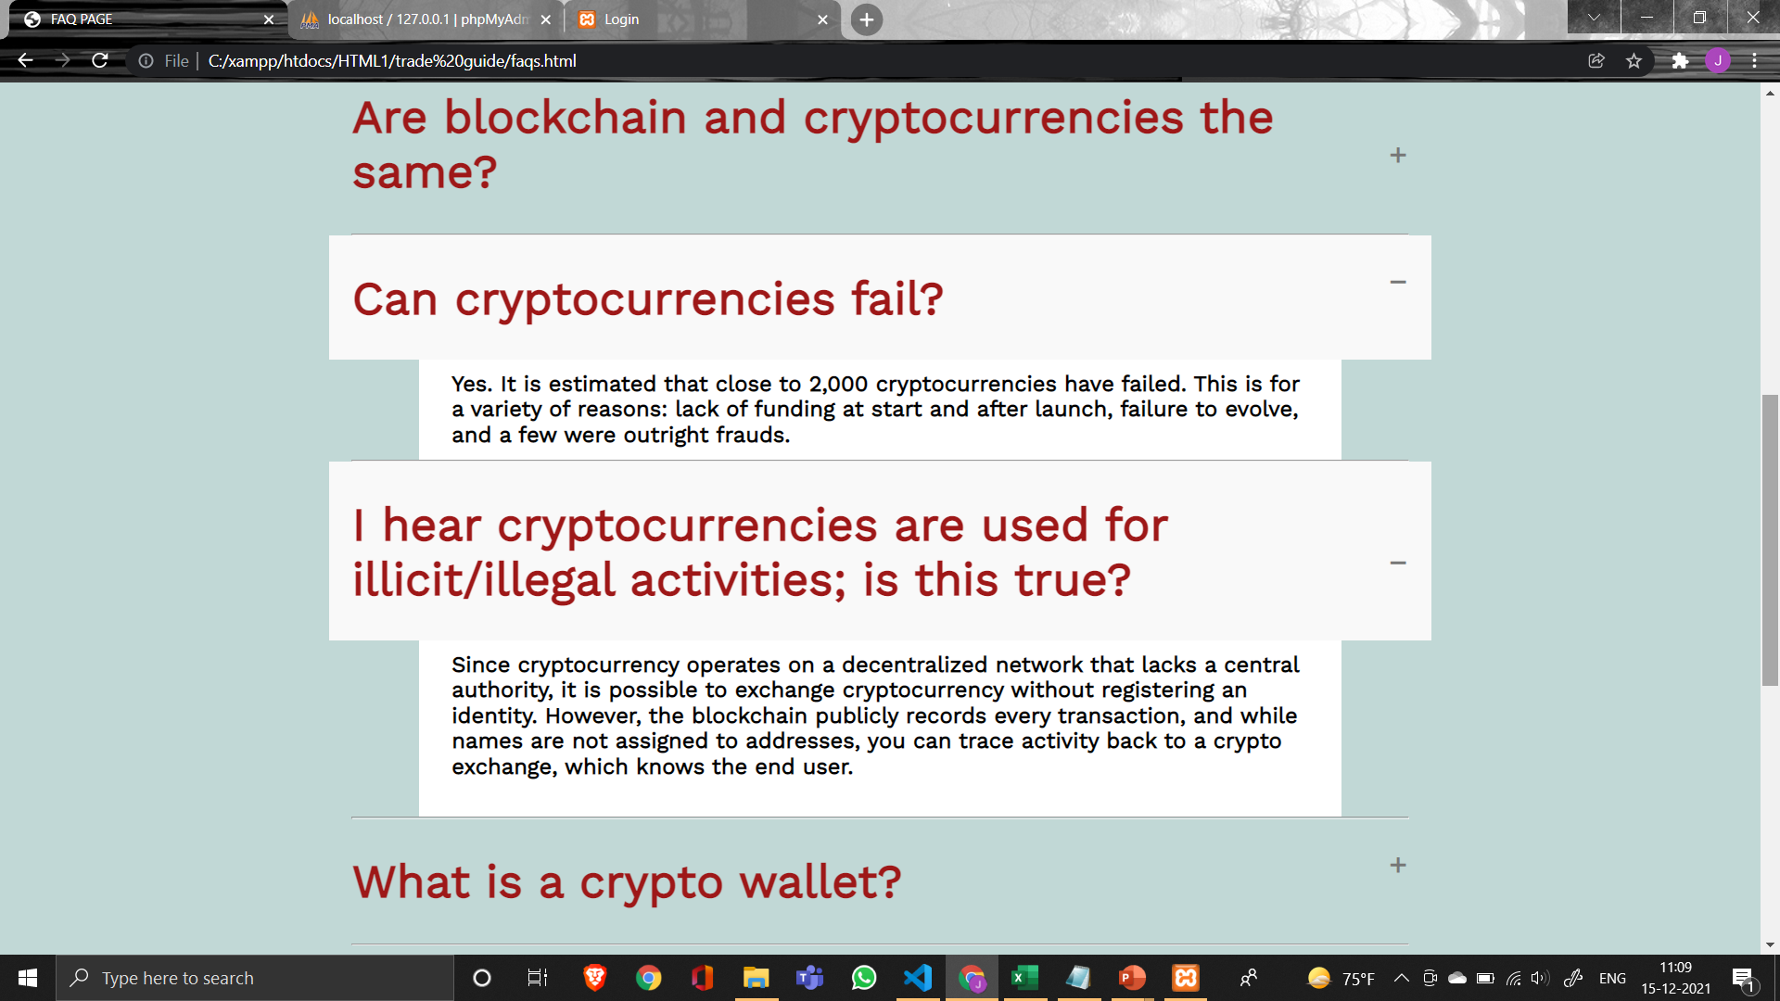
FAQS PAGE :

